Slide 1
GLOBAL CONTEXT
Identities and relationships
Students will explore identity and communicate their ideas and beliefs about their own background.
Statement of Inquiry: Composition communicates a narrative.

Slide 2
&
Composition
Identity
While studying the concept of composition, the arrangement of elements within a work of art, student-artists created designs using letters, numbers, logos, and symbols. Students looked at the concepts of communication, presentation, and that of a narrative, “telling viewers a story” about themselves with these colorful pieces!
-Mr. Smith & Ms. Salatino

Slide 3
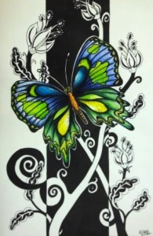
Beyond
Borders

Slide 4
KEY CONCEPT
COMMUNICATION
Related Concepts
IDENTITY
COMPOSITION
PRESENTATION
NARRATIVE

Slide 5
ATL 1 SELF MANAGEMENT
Organization Skills
Reflection Skills
Process Journal Work
ATL 2 THINKING
Creative Thinking Skills
Transfer Skills
Ideas to final product

Slide 6
COMPOSITION?
What is it? Where have you heard this word before? Is it used in other classes?

Slide 7
Composition: Arrangement of elements in art.
C
C

Slide 8
What are your thoughts on this composition? Is it interesting?

Slide 9
What about this composition?

Slide 10
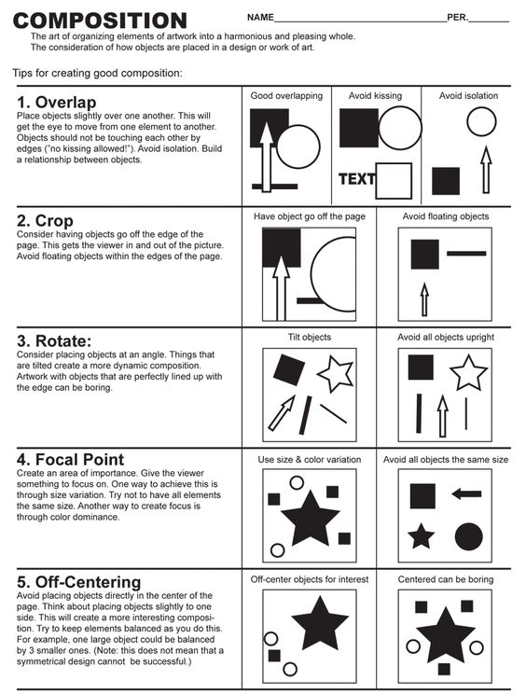

Slide 11
Let’s practice our composition skills.
Give me a…
Number
Letter
And Symbol (picture or shape)

Slide 12
Let’s practice YOUR composition skills.
Draw 4 empty boxes in your sketchbook
Draw 4 different compositions using:
a letter
a number
A symbol or shape

Slide 13
The Power of Symbols & Logos
(represent and associate with different products)

Slide 14
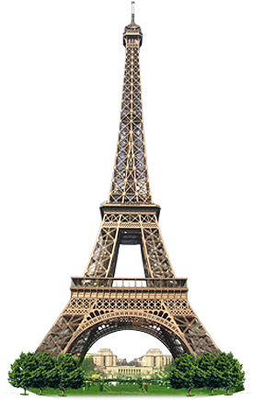
SYMBOLS can be more than just products or companies

Slide 15
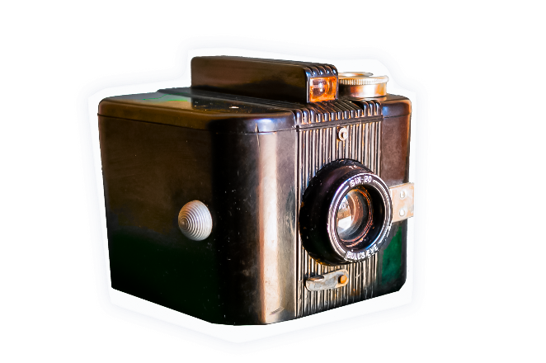
Identity – is the distinguishing character or personality of an individual

Slide 16
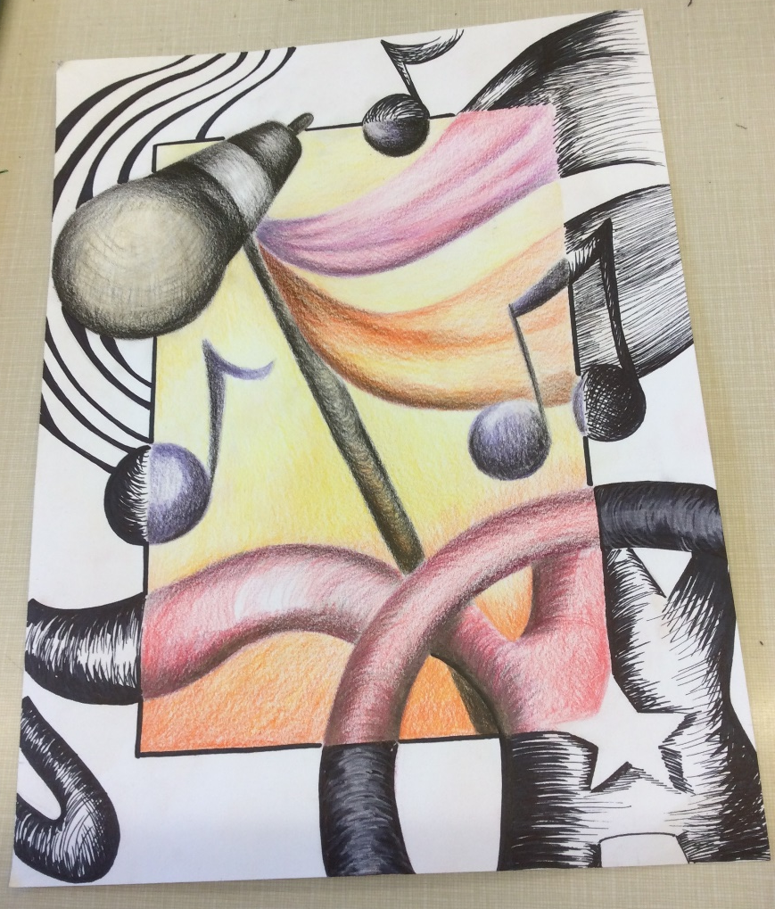
What are we doing for our first project?
We will be creating an image that represents YOU using symbols, logos and pictures to represent and create a visual story. This visual story will give the viewer insight into you, the artist.
These images will be breaking out of their border using colored pencil and permanent ink.

Slide 17
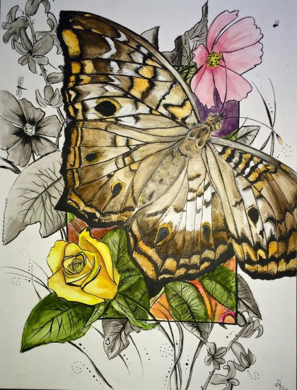
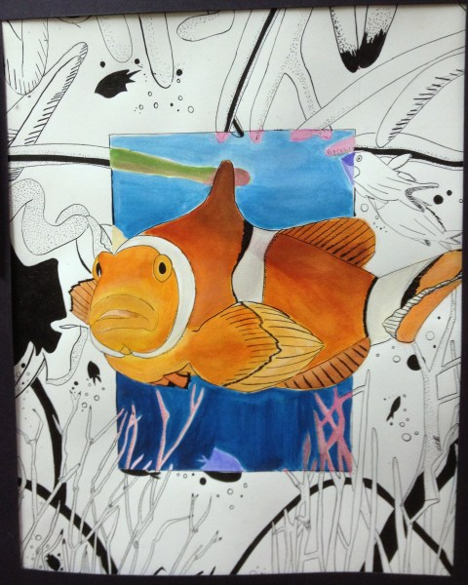
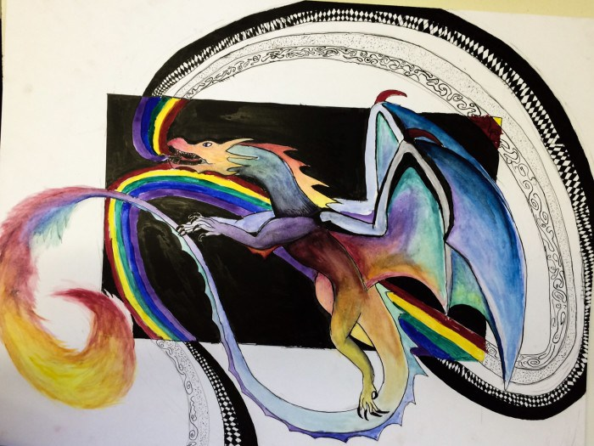

Slide 18
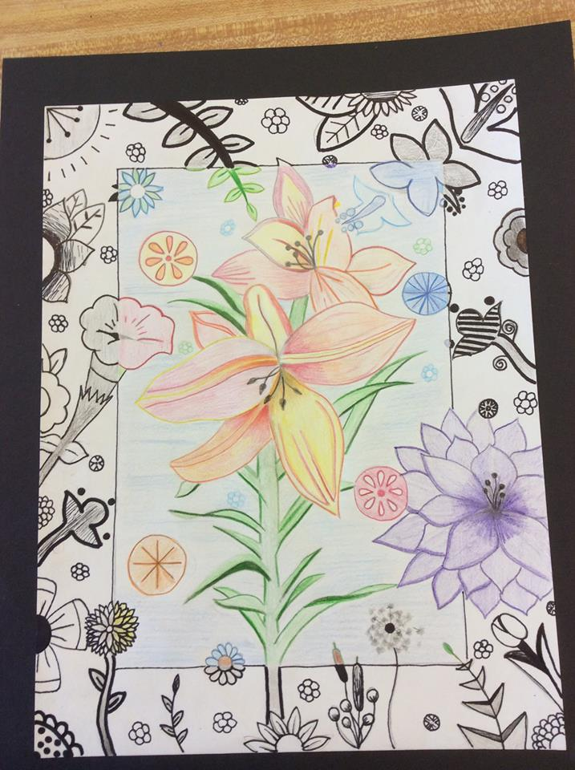
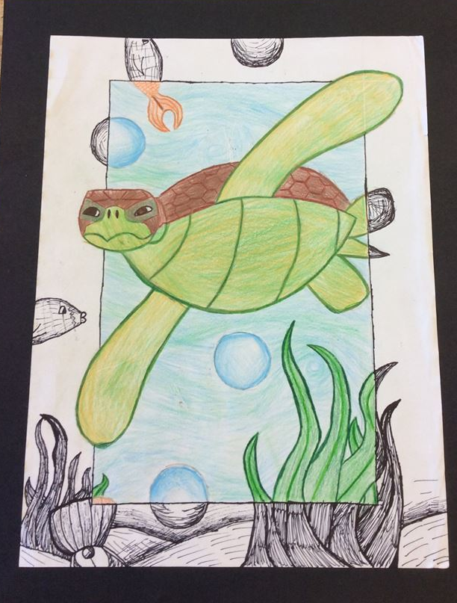
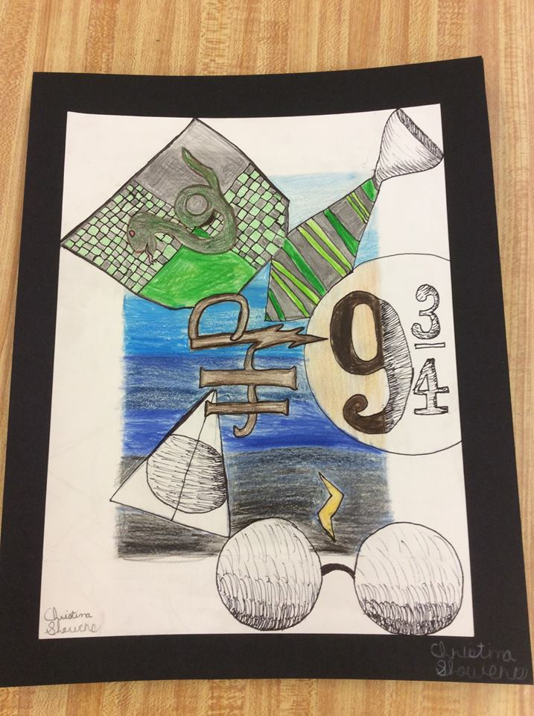
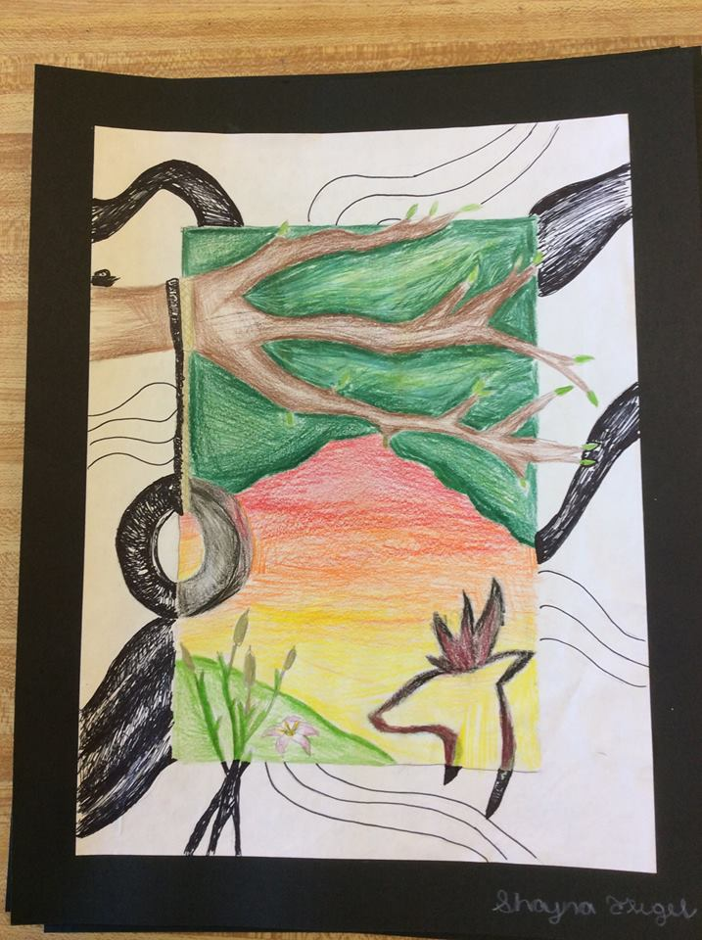
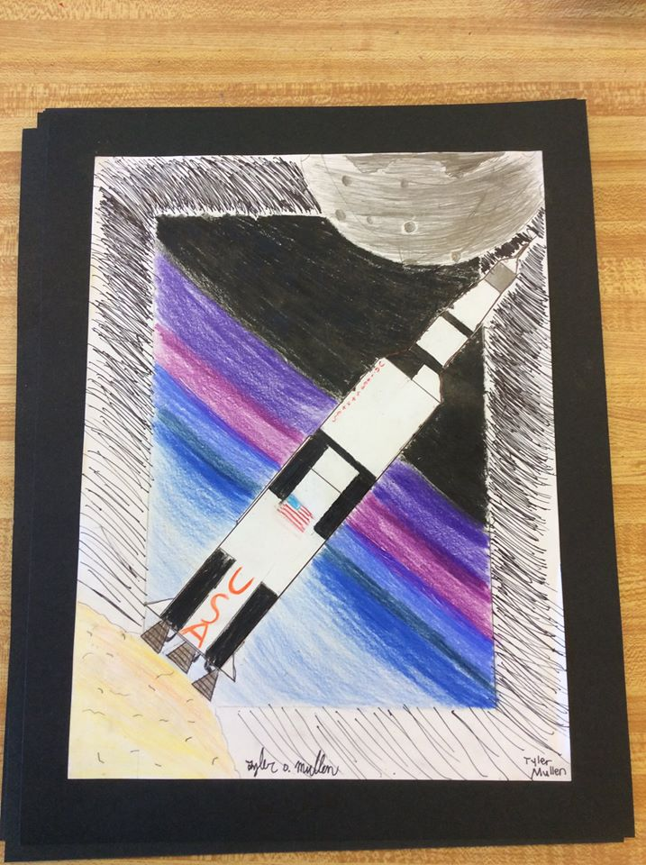
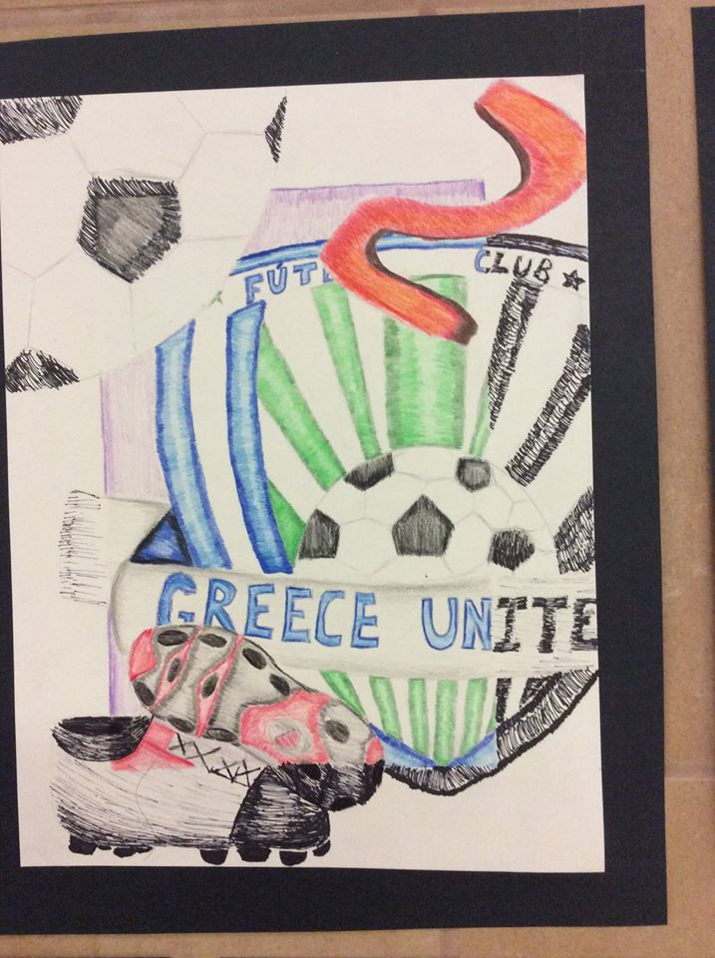

Slide 19
What are the steps?

Slide 20
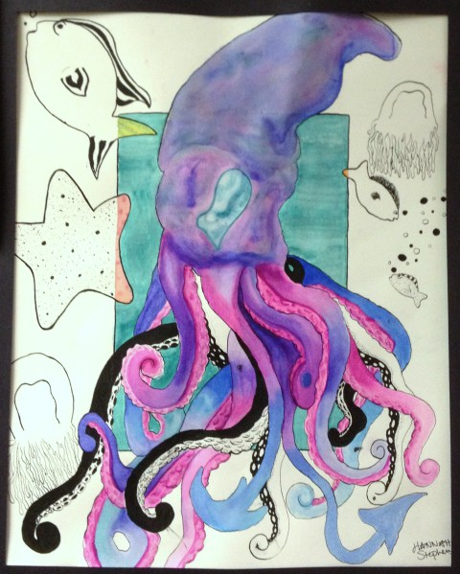
Criteria (what you need to include):
Use a few symbols, colors, shapes, and letters/numbers to create a “portrait” of yourself!
You will need:
BORDER: You should have an enclosed shape that defines your visual boundary.
SYMBOLS: 1-3 symbols about yourself, interests or other things about you!
COLOR: The object within the border should be in full color while the outside space should be in black and white.
ELEMENTS: Shapes, lines, numbers, or other symbols to add to the poster.
A GOOD COMPOSITION: Put it together in a way that creates an interesting, vibrant poster!

Slide 21
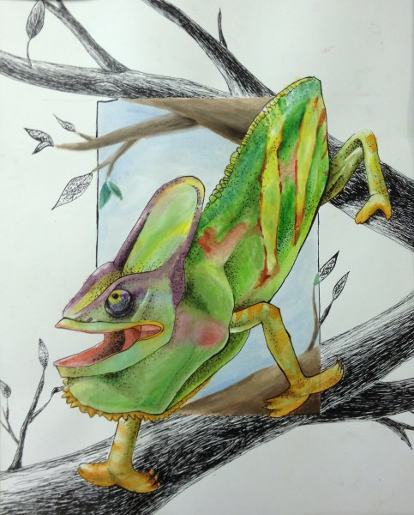
A good composition has:
BALANCE: Is the “weight” of the colors or light/dark spread out well?
UNITY: Does everything look like it goes together?
MOVEMENT: Does the piece make you move your eyes around? IS IT INTERESTING??

Slide 22
Before we get to our final project we need to
BRAINSTORM

Slide 23
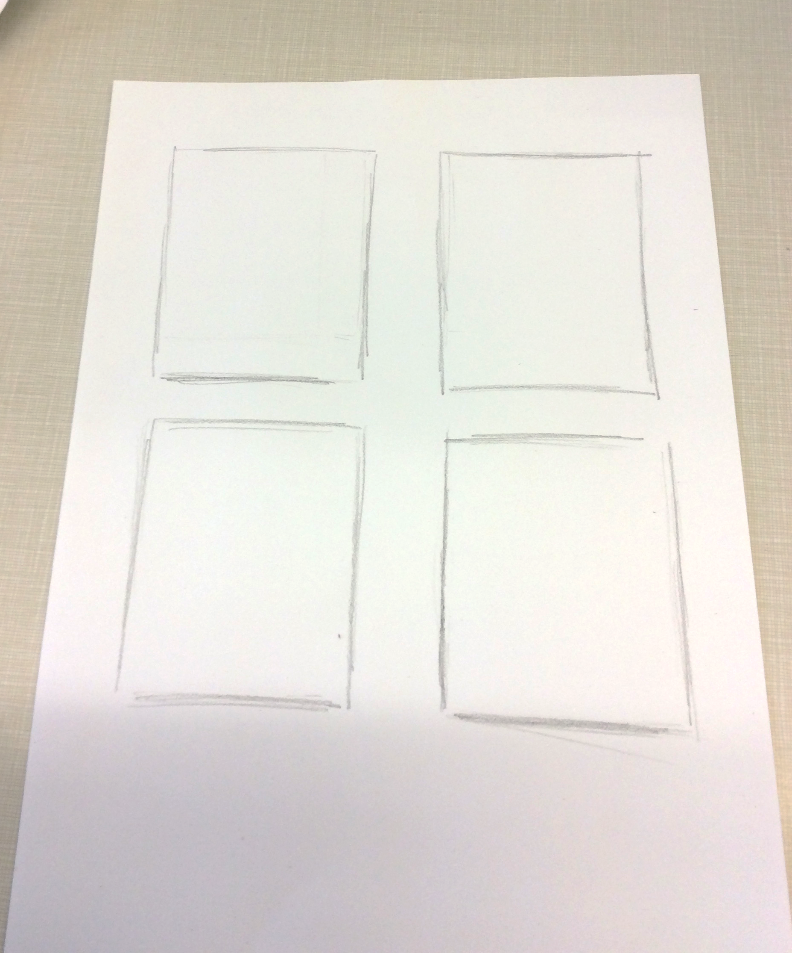
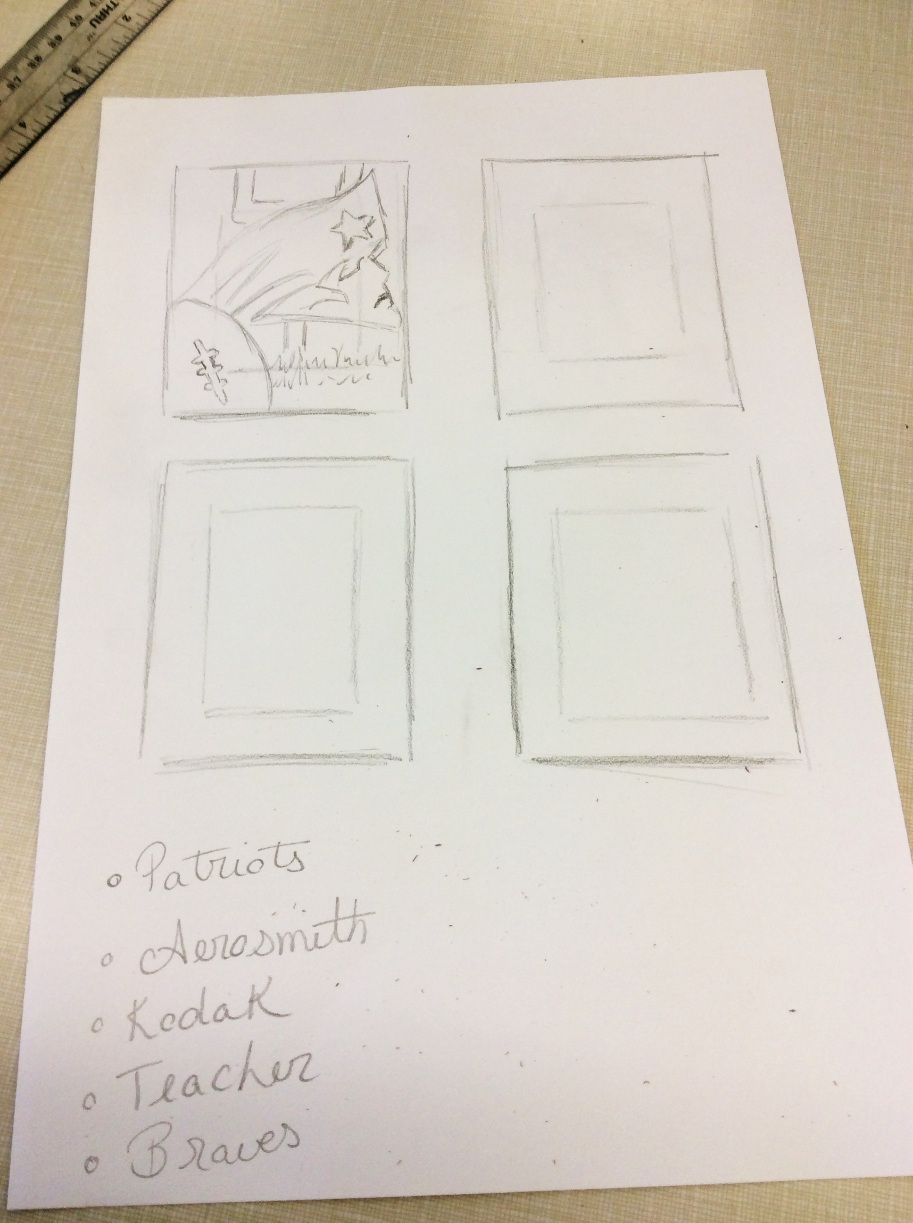
1. Draw 4 boxes
2. Draw a SMALLER box inside each of your 4 boxes

Slide 24
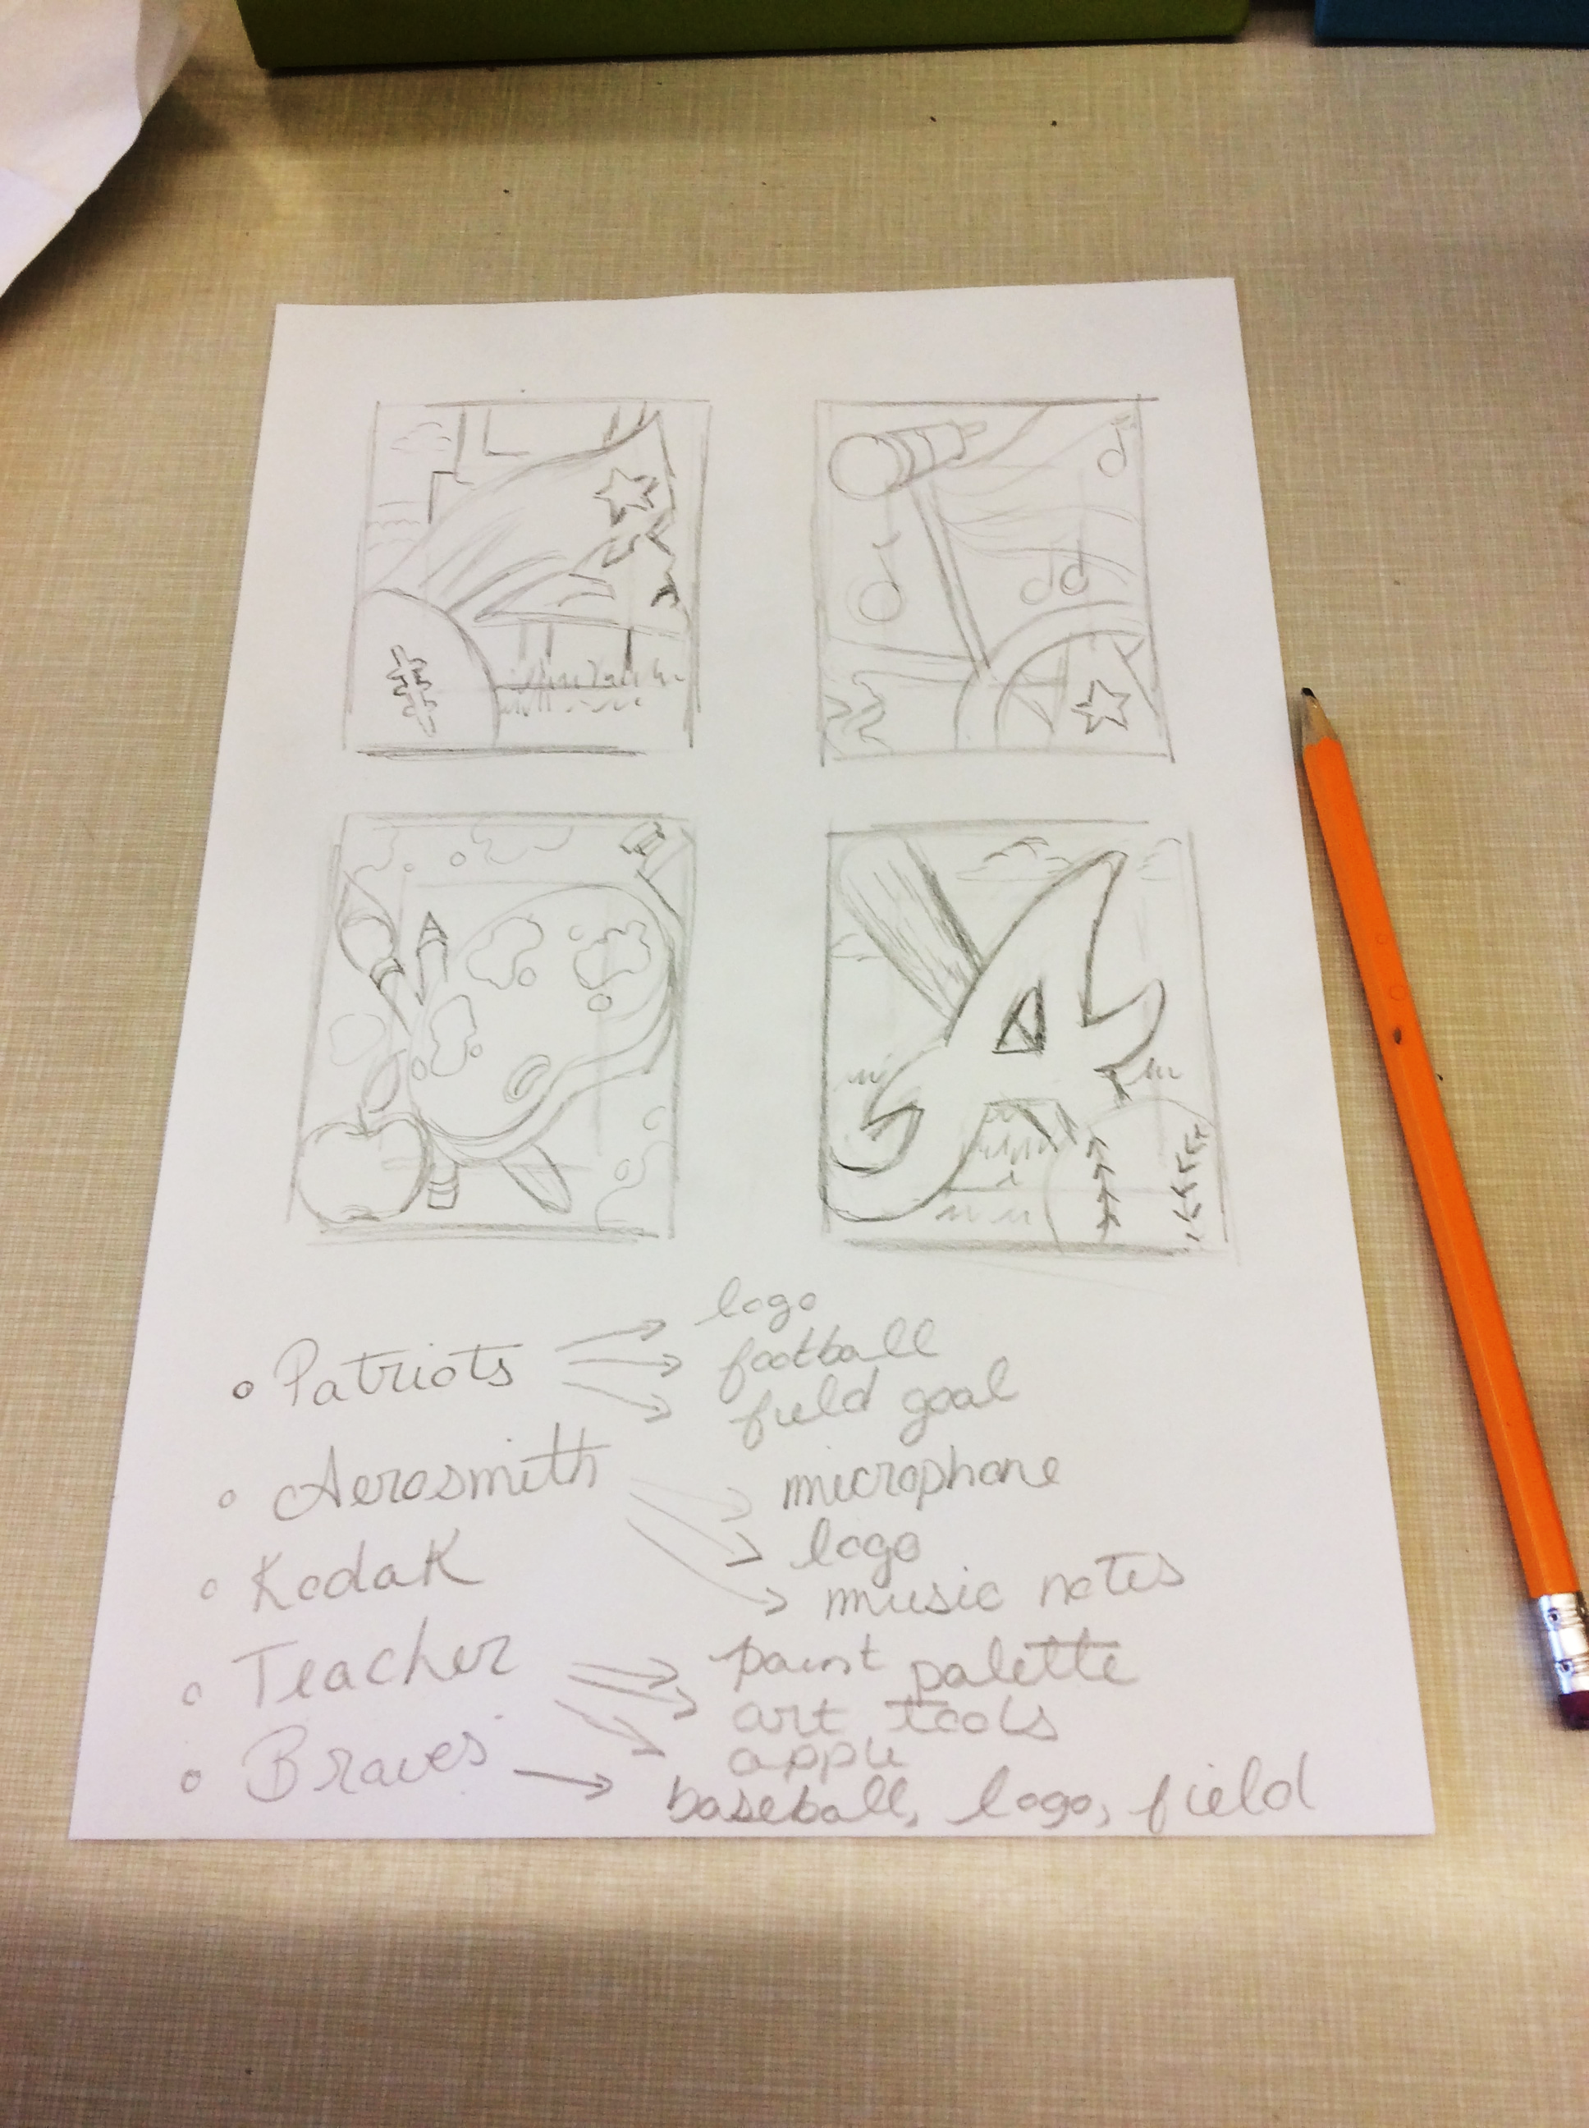
3. Brainstorm some ideas
4. Draw out your thumbnail sketches

Slide 25
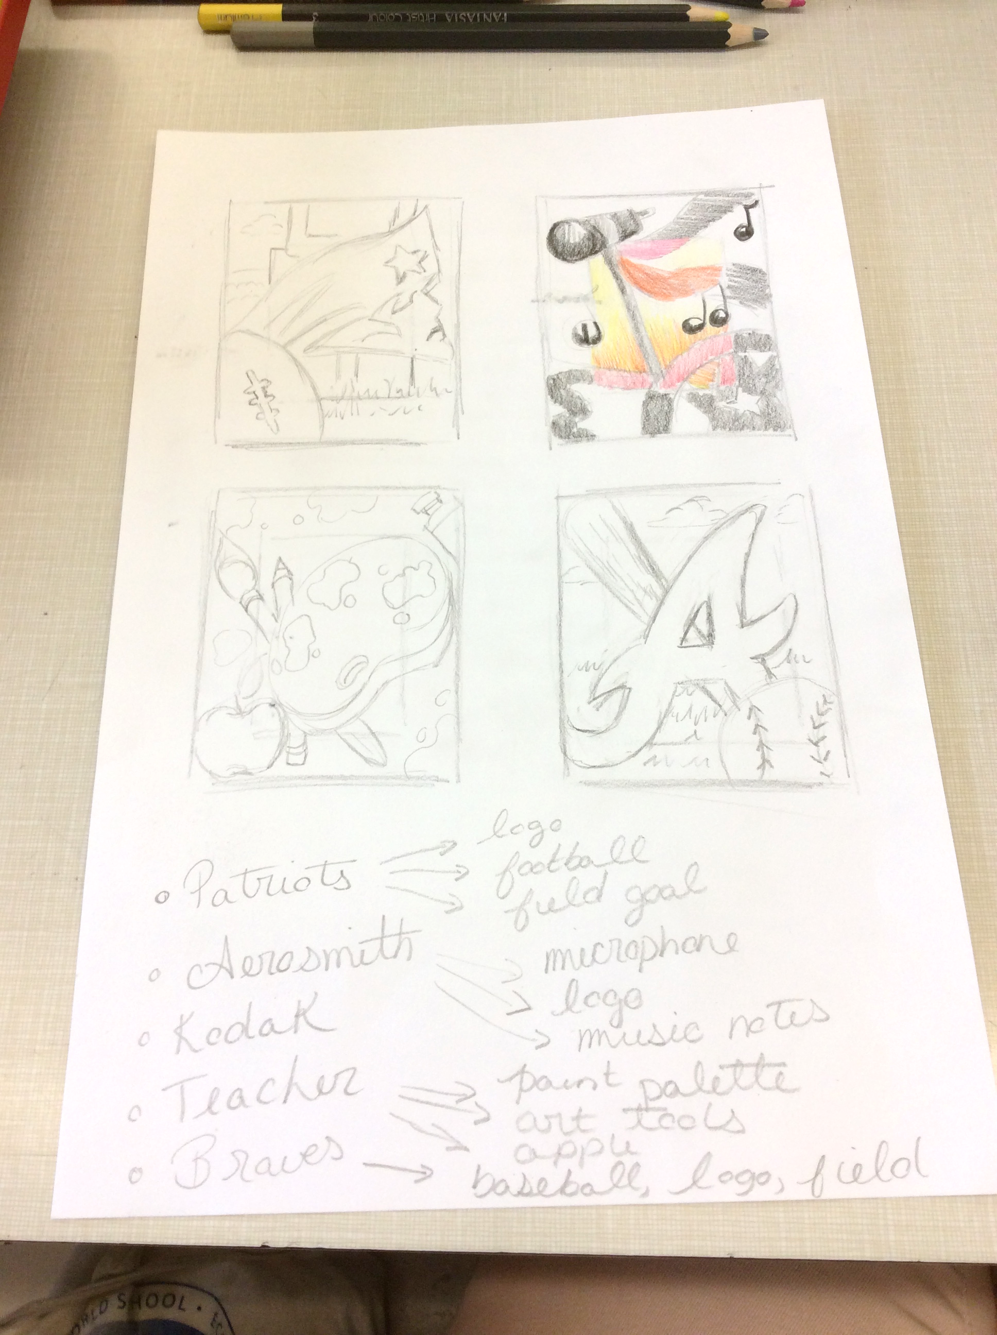
5. Choose your best design and add color using colored pencil

Slide 26
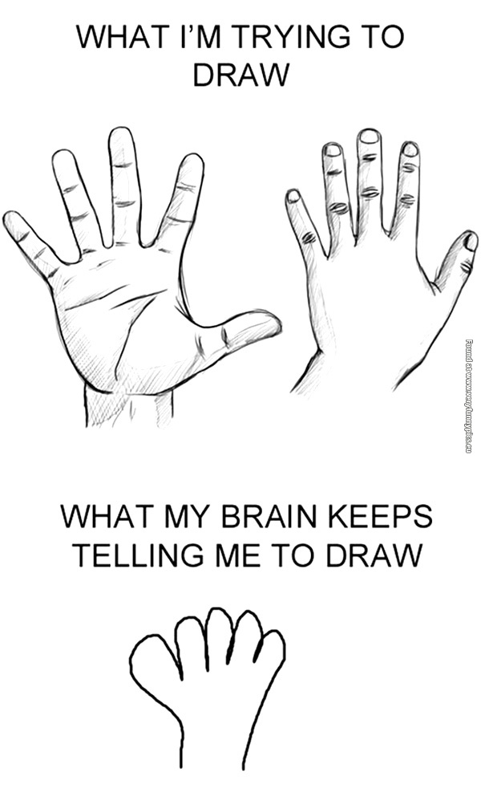
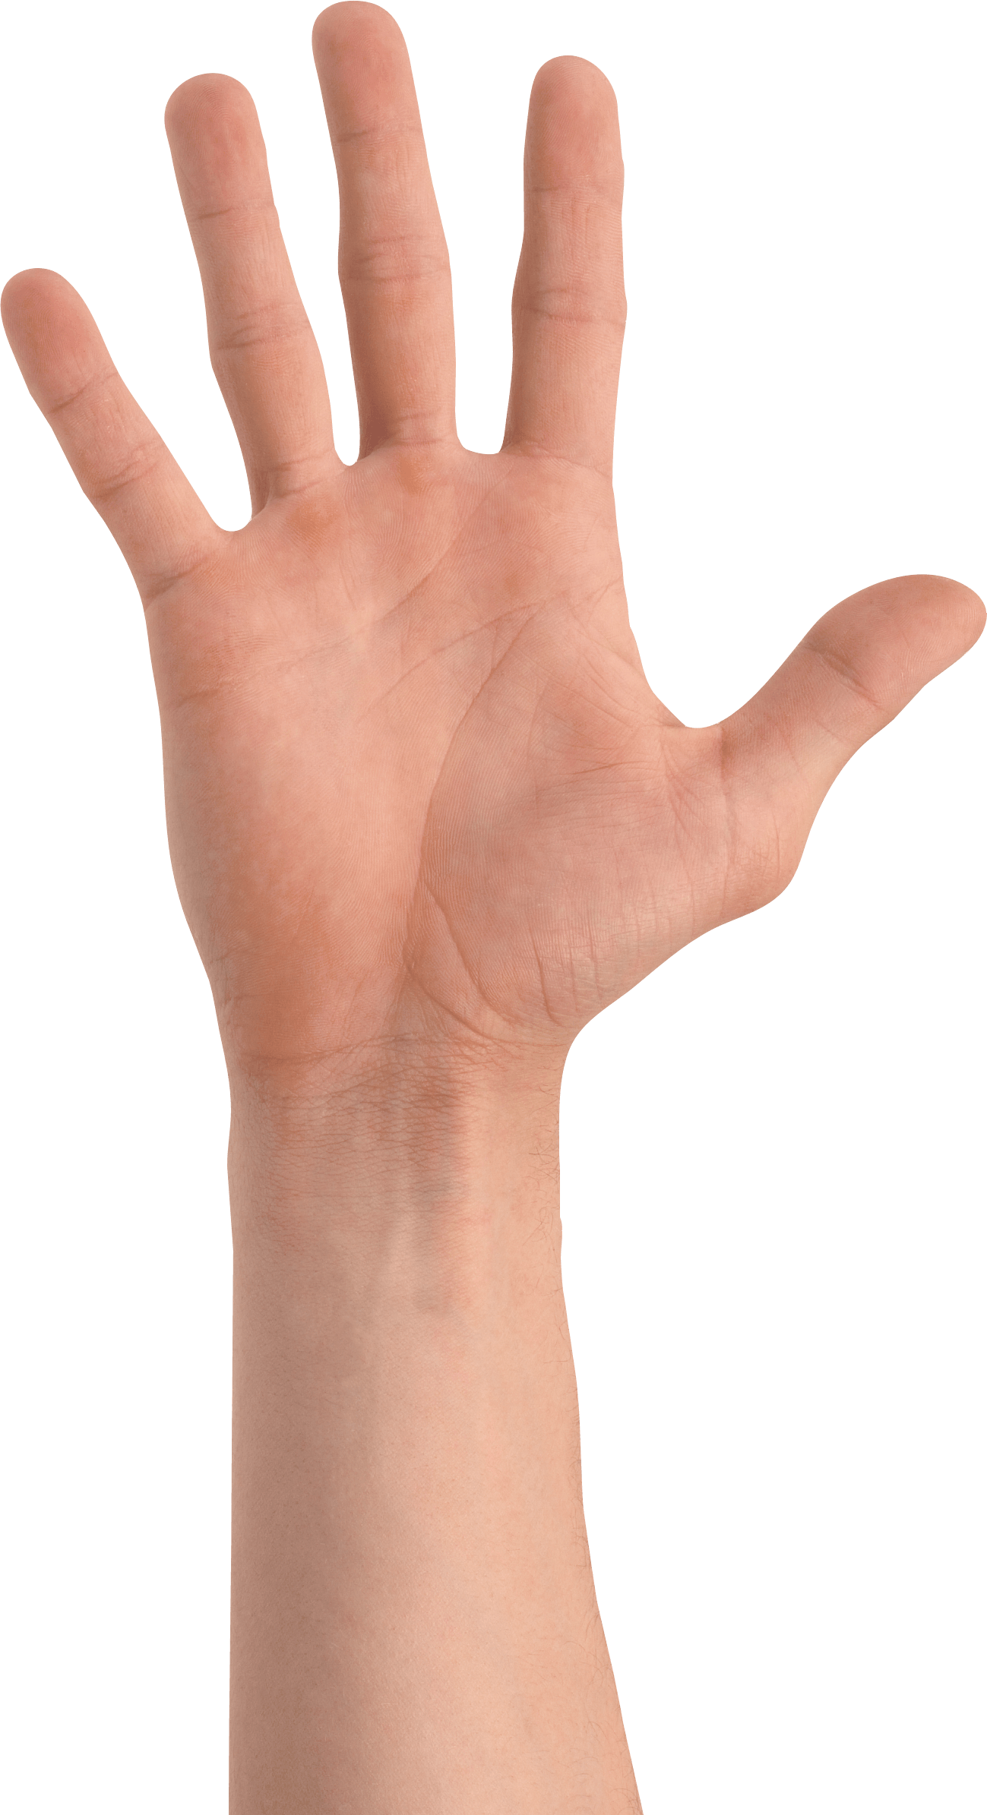
Using References= Better, more successful drawing
Drawing from your memory= not as good. So use a reference!

Slide 27
Final Copy

Slide 28
Part 1
Part 2
Part 3
Measure out our border
Sketch out your design in PENCIL
Add color ONLY to the CENTER
Add black and white value using Sharpie

Slide 29
Grab a ruler and measure out 1.5 inches on each side

Slide 30
Connect your marks using a ruler. DRAW THEM EXTREMELY LIGHT!

Slide 31
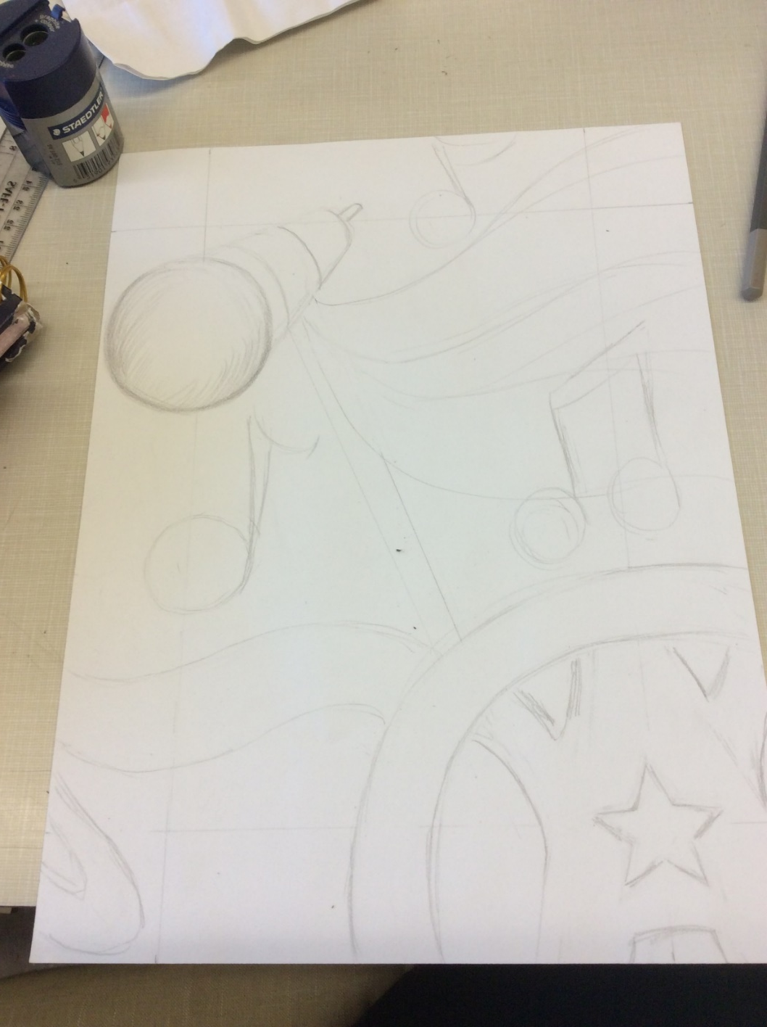
Sketch in your design LIGHTLY!

Slide 32
Adding Color

Slide 33
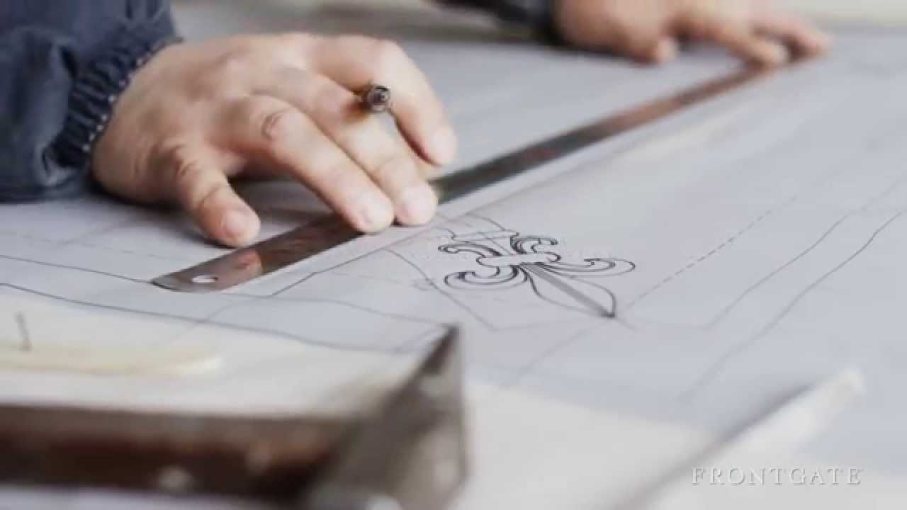
Craftsmanship-
The quality of design and work shown in something made by hand.
“how neat it is”

Slide 34
Value- the lightness and darkness of a color

Slide 35
Blending- the gentle and gradual transition from one color to the other

Slide 36
Color Mixing- when you mix two different colors together to produce a new color.

Slide 37
Directional Shading helps transform a shape and gives it the illusion of form using curved lines. By coloring with curved lines, this helps the apple look like it has form.

Slide 38
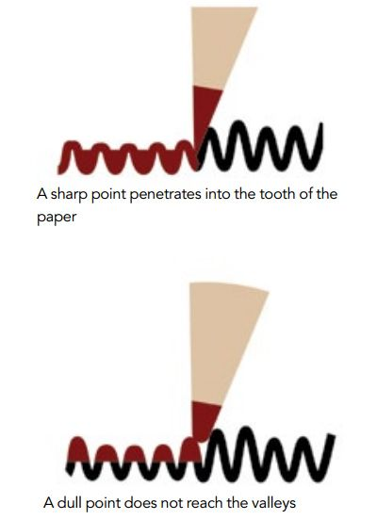
Make sure your pencils are always sharp

Slide 39
Adding
Ink

Slide 40
We will be adding black and white value to the outside border using Sharpie.

Slide 41
NOTES: OBJECTIVE B
“Work” = composition artwork
“Skills/Principles” = materials, balance/unity/emphasis/contrast
“Preliminary Work” = practice example(s) or thumbnails
Objective B: Developing Skills
Achievement Level | Level Descriptor | Student Grade | Final Grade | Indicators
0 | The student does not reach a standard described by any of the descriptors below
1-2 | The student: i. demonstrates limited acquisition and development of the skills and techniques of the art form studied ii. demonstrates limited application of skills and techniques to create, perform and/or present art. |  |  | Work is careless/does not reflect research. Improvement of skills/principles from the pre-asssesment is not evident or improved upon Work is carelessly smudged/dirty/damaged Student shows little to no use of individual instruction/exploration. Preliminary work was not completed.
3-4 | The student: i. demonstrates adequate acquisition and development of the skills and techniques of the art form studied ii. demonstrates adequate application of skills and techniques to create, perform and/or present art |  |  | Work is a sufficient reflection of the source/research. Improvement of skills/principles from the pre-assessment is sufficiently evident Work should be cleaner or repaired. Student shows a portion of individual instruction/exploration. Preliminary work was partially completed.

Slide 42
NOTES: OBJECTIVE B
“Work” = composition artwork
“Skills/Principles” = materials, balance/unity/emphasis/contrast
“Preliminary Work” = practice example(s) or thumbnails
Objective B: Developing Skills
Achievement Level | Level Descriptor | Student Grade | Final Grade | Indicators
5-6 | The student: i. demonstrates substantial acquisition and development of the skills and techniques of the art form studied ii. demonstrates substantial application of skills and techniques to create, perform and/or present art. |  |  | Elements reflect the source/research. Improvement of skills/principles from the pre-asssesment is clearly in use. Work has minor un-necessary smudging or creasing/damage. Student shows use of individual instruction/exploration. Preliminary work and ideas were varied and mostly completed.
7-8 | The student: i. demonstrates excellent acquisition and development of the skills and techniques of the art form studied ii. demonstrates excellent application of skills and techniques to create, perform and/or present art. |  |  | Elements clearly reflect the source/ imagery/ research, and are improved (pre-tests etc.) Improvement of skills/principles from the pre-assessment is very evident. Work is clean and well presented. Student shows use of individual instruction/exploration. Preliminary work and ideas were fully elaborated and completed

Slide 43
Objective C: Thinking Creatively
NOTES: OBJECT IVE C
“Work” = Composition process artwork
“Skills/Principles” = Materials, balance/unity/emphasis/contrast
“Preliminary Work” = practice example(s), drawings, or thumbnails
Achievement Level | Level Descriptor | Student Grade | Final Grade | Indicators
0 | The student does not reach a standard described by any of the descriptors below
1-2 | The student: i. presents a limited outline of an artistic intention, which may lack clarity or feasibility ii. presents a limited outline of alternatives, perspectives, and imaginative solutions iii. demonstrates limited exploration of ideas through the developmental process, which may lack a point of realization.. |  |  | Skills/Principles are weak or ignored. Work is carelessly messy/dirty/damaged Preliminary work was not completed.
3-4 | The student: i. presents an adequate outline of a clear and/or feasible artistic intention ii. presents an adequate outline of alternatives, perspectives, and imaginative solutions iii. demonstrates adequate exploration of ideas through the developmental process to a point of realization |  |  | Required skills/principles are developing Work should be cleaner or repaired. Preliminary/practice sketches are limited Required amount of preliminary/practice sketches or ideas are not completed and/or are not developed

Slide 44
NOTES: OBJECT IVE C
“Work” = Composition process artwork
“Skills/Principles” = Materials, balance/unity/emphasis/contrast
“Preliminary Work” = practice example(s), drawings, or thumbnails
Objective C: Thinking Creatively
Achievement Level | Level Descriptor | Student Grade | Final Grade | Indicators
5-6 | The student: i. presents a substantial outline of a clear and feasible artistic intention ii. presents a substantial outline of alternatives, perspectives, and imaginative solutions iii. demonstrates substantial exploration of ideas through the developmental process to a point of realization. |  |  | Required skills/principles are clearly in use. Work has un-necessary messiness or is creased/damaged. Preliminary/practice sketches have some variety/ different ideas. Required amount of preliminary/practice sketches or ideas are completed and are adequately developed
7-8 | The student: i. presents an excellent outline of a clear and feasible artistic intention ii. presents an excellent outline of alternatives, perspectives, and imaginative solutions iii. demonstrates excellent exploration of ideas through the developmental process to a point of realization. |  |  | Required skills/principles are very evident. Work is clean and well presented. Preliminary/practice sketches are fully elaborated and show a variety of different ideas. Required amount of preliminary/practice sketches or ideas are completed and are fully developed

